Slide 1
Applied AI
Lecture 1
Dr Artie Basukoski

Slide 2
IIT Lecture Panel
Prof. Nihal Kodikara
Nihal.k@iit.ac.lk
Mr. Nipuna Senanayake
nipuna.s@iit.ac.lk
Mr. Isuru Kariyawasam
isuru.ka@iit.ac.lk

Slide 3
Agenda
Introduction
Assessment
Resources
Lectures
Seminars
History, developments, issues
Next steps

Slide 4
What is AI?
Come up with your own definition before the lecture.
We will fill in a definition after we discuss this in the lecture.
Definition:

Slide 5
Introduction
Aims: To give the student the background knowledge and practical skills to use and evaluate AI techniques over a range of problem domains.
Understand the fundamental concepts, issues, and techniques of AI.
Implement and use AI techniques across a broad range of AI sub-fields.
Evaluate when and under what conditions it is appropriate to use each AI technique.
Understand the historical background and evolution of AI techniques.
Each week an essential technique will be demonstrated via a working implementation followed by a presentation of the theory and conditions needed to enable the student to set up and use the techniques themselves. Guest presentations by experts in a relevant topic will be arranged where possible.

Slide 6
Assessment
Session | Period | Assessment Type | Assessment Name | Weight | Qual Mark | Due Date
2021/2 | SEM1 | Coursework | Coursework | 50 | 30 | Wed, 12th Jan 12-01-2022
2021/2 | SEM1 | In-Class Test/Assignment exam conditions | In-Class Test | 50 | 30 | Week 12 In your seminar (must attend in person or seek MC)

Slide 7
Resources
Your main resource will be the book Artificial Intelligence: A Modern Approach, Russel and Norvig
Access via the Reading List on Blackboard
Sample code in many languages and available on the book website:
https://github.com/aimacode
The web (obviously)
Guest lecturers

Slide 8
Lecture schedule
Introduction and History of AI
Agents and Environments
Problem Solving
Planning
Knowledge representation and reasoning
Engagement week
Uncertain Knowledge and Reasoning
Neural Networks
Speech and Language Processing (Dr Maria Chondrogianni)
Computer Vision/Deep Learning (Dr Aleka Psarrou)
Reinforcement Learning/Deep Learning (Dr Dimitris Dracopoulous)
Revision session

Slide 9
Seminar/tutorial schedule
No Seminar – Seminar Exercises will be released every Friday.
Python, Jupyter and development environment.
Search Algorithms in Agent Environment
Planning – Adversarial search
Knowledge representation and reasoning
Engagement week – No seminar/tutorial
Probabilistic Reasoning
Neural Networks
Speech and Language Processing (Dr Maria Chondrogianni)
Computer Vision/Deep Learning (Dr Aleka Psarrou)
Reinforcement Learning/Deep Learning (Dr Dimitris Dracopoulous)
In-class test in your allocated seminar.

Slide 10
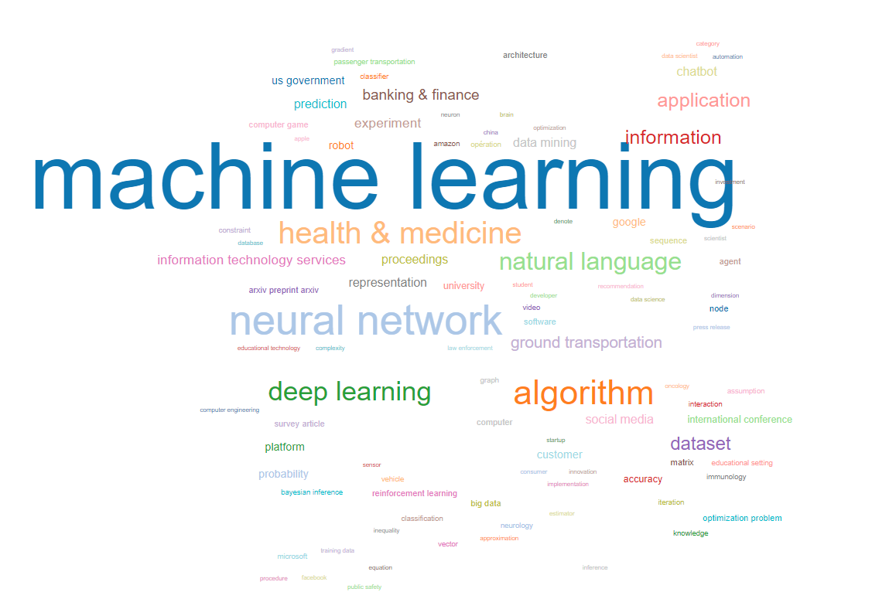
AI Topics
https://aitopics.org/search#

Slide 11
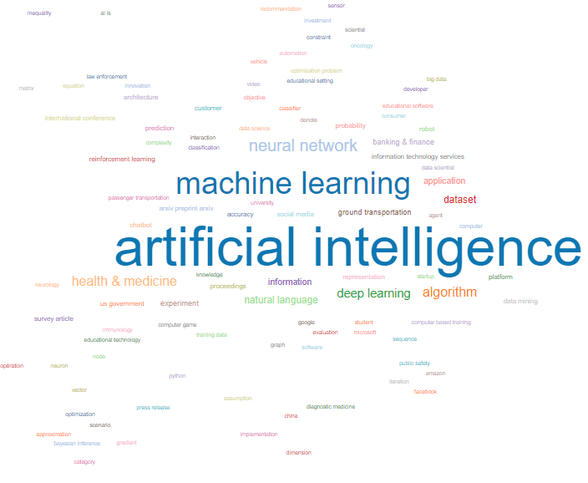
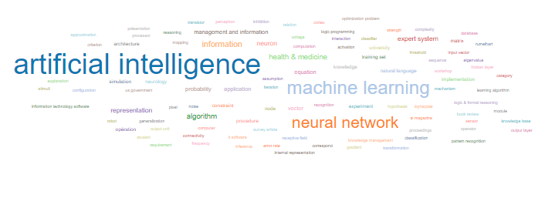
AI – Then and Now
1986-1990 vs 2017-2021
What are the main differences?
Explore other periods on your own.

Slide 12
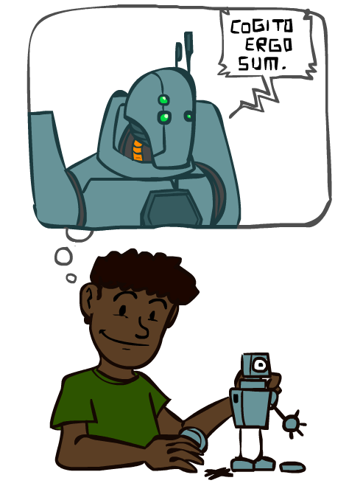
A (Short) History of AI
1940—1950: Early days
1943: McCulloch & Pitts: Boolean circuit model of brain
1950: Turing's “Computing Machinery and Intelligence”
1950—70: Excitement: Look, Ma, no hands!
1950s: Early AI programs, including Samuel's checkers program, Newell & Simon's Logic Theorist, Gelernter's Geometry Engine
1956: Dartmouth meeting: “Artificial Intelligence” adopted
1965: Robinson's complete algorithm for logical reasoning
1970—90: Knowledge-based approaches
1969—79: Early development of knowledge-based systems
1980—88: Expert systems industry booms
1988—93: Expert systems industry busts: “AI Winter”
1990—2012: Statistical approaches + subfield expertise
Resurgence of probability, focus on uncertainty
General increase in technical depth
Agents and learning systems… “AI Spring”?
2012—: Excitement: Look, Ma, no hands!
Big data, big compute, neural networks
Some re-unification of subfields
AI used in many industries
Source CS188 Lectures

Slide 13
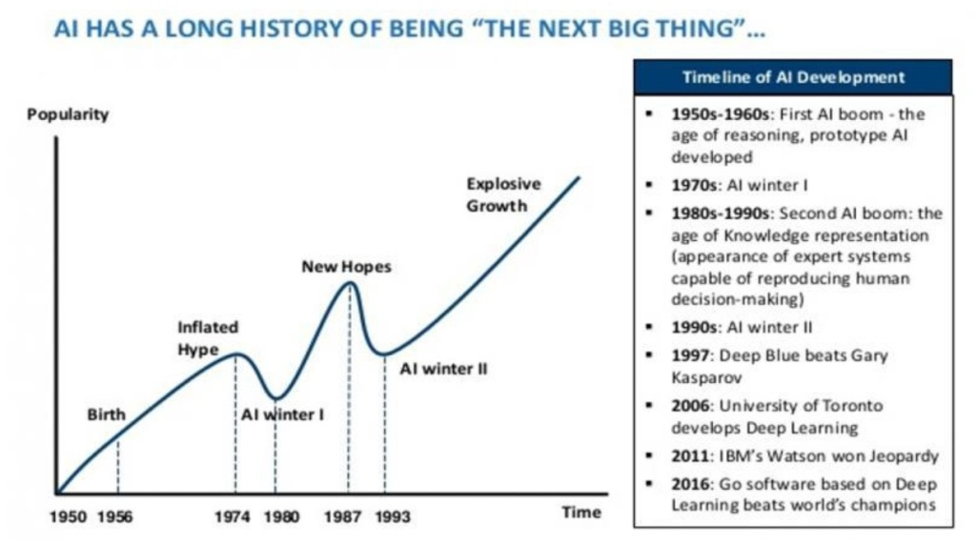
AI Promises

Slide 14
Golden Age or another AI Winter?
https://venturebeat.com/2019/11/16/is-ai-in-a-golden-age-or-on-the-verge-of-a-new-winter/
Lots of hype but also something is different (non toy-domain results)
Some of the success can be attributed to advancement of computational capability and availability of ‘big data’
AI is always the next big thing, hence never attainable. Should we call it Computational Intelligence to tone down the hype?
Money and marketing vs Scientific reality. Gartner predicts 16Trillion industry by 2030!

Slide 15
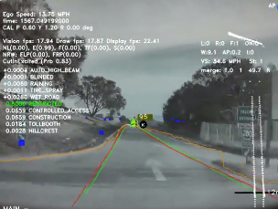
Recent Developments
https://deepmind.com/about
https://www.tesla.com/en_GB/AI
arXiv.org approx. 43000 papers on Artificial Intelligence

Slide 16
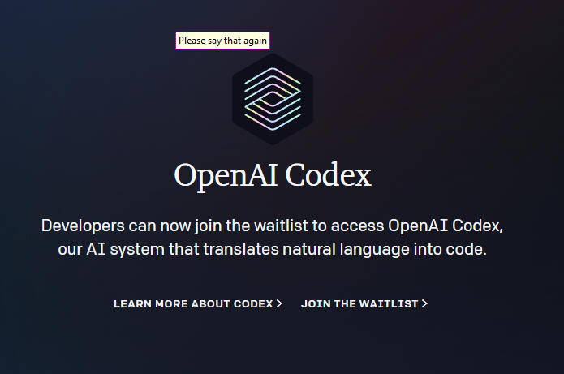
Recent developments

Slide 17
Photo: Google / Getty Images
Notes:
Lee Se-dol while playing the AI
Clearly the agents are becoming more impressive.
This is using huge computation on a single problem, what can simpler algorithm do?

Slide 18
Issues and concerns with AI
During last semester’s Engagement Week we discussed issues and concerns surrounding AI. Some suggestions were:
Ethical/Legal implications – if AI is mainstream who is responsible?
What happens if/when we reach the singularity – many have weighed in on this topic including – Hawkings, Musk, Kurzweil etc
Can AI achieve Consciousness? Is General AI even possible? Mind transfer?
Inherent bias in data? AI favours men for jobs due to historic training data
Can you think of others?

Slide 19
Advantages and benefits of AI
Higher intelligence brings greater insight and understanding. Did AlphaGo destroy the game of Go?
AI/Robots can do jobs that humans cannot. Greater efficiency 24x7, productivity and hence quality of life.
Autonomous wars – no/less humans involved?

Slide 20
Tutorial (Seminar)
No onsite tutorial this week but you can do some home study.
Find your favourite example of AI, one from fiction and one from real life. For example, HAL9000 from the movie 2001 A space Odyssey, and Alpha Zero (Go implementation)
Famailiarise yourself with the book.
Read chapter 1. Introduction.
Revise your python knowledge from first year.
In next weeks seminar we will cover Python and work through the environment we will be using: Anaconda, jupyter notebook, how to install libraries.

Slide 21
Questions Discussion?

